Slide 1
Tree Grow
Olivia G 301974

Slide 2
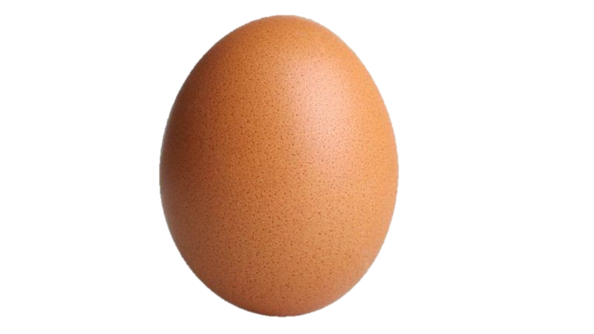
Story
Click and grow your tree to be the biggest tree of them all

Slide 3

Incorporation of the Concept/Mechanic
You play as a tree and do tree like things

Slide 4
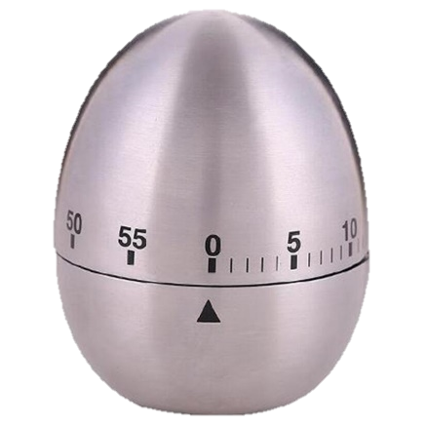
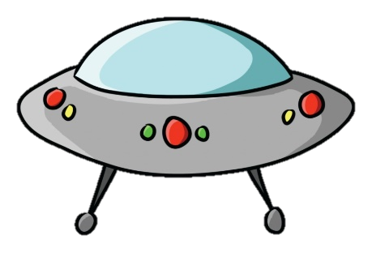
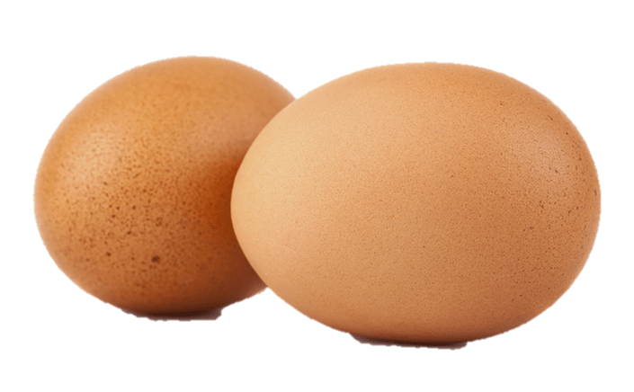
Additional Mechanics
Timer
Growth System
Growth Challenges (wind)

Slide 5
Controls
Left click in the day to gain food
Hit Alt to gain food when raining
Hit the grow button to grow taller lowering your food.
WASD
Center

